Slide 1

A Good Soldier Or Random Exposure? Chance Opportunities & Frequent Citizenship

Slide 2
Inspiration

Slide 3
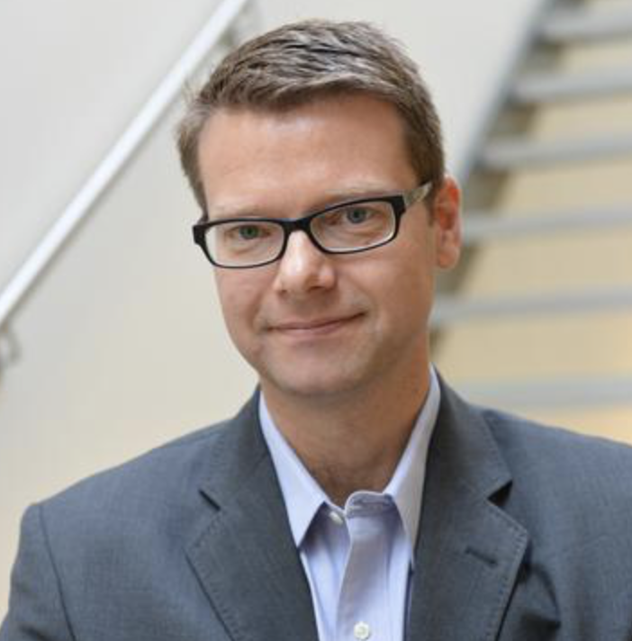
Inspiration

Slide 4
Inspiration
Random

Slide 5
Inspiration
Random
…variation should be considered one of the most important explanatory mechanisms in the management sciences

Slide 6
Inspiration
Random
…variation should be considered one of the most important explanatory mechanisms in the management sciences
…events impact organizational behavior

Slide 7
Inspiration
Random
…variation should be considered one of the most important explanatory mechanisms in the management sciences
…events impact organizational behavior
…models provide parsimonious explanations of empirical regularities

Slide 8
Inspiration
Random
…variation should be considered one of the most important explanatory mechanisms in the management sciences
…events impact organizational behavior
…models provide parsimonious explanations of empirical regularities
How Long Must A Firm Be Great To Rule Out Chance?
– Henderson, Raynor, & Ahmed, 2012

Slide 9

Inspiration
Random
…variation should be considered one of the most important explanatory mechanisms in the management sciences
…events impact organizational behavior
…models provide parsimonious explanations of empirical regularities
How Long Must A Firm Be Great To Rule Out Chance?
– Henderson, Raynor, & Ahmed, 2012

Slide 10
Inspiration
Random
…variation should be considered one of the most important explanatory mechanisms in the management sciences
…events impact organizational behavior
…models provide parsimonious explanations of empirical regularities
How Long Must A Firm Be Great To Rule Out Chance?
– Henderson, Raynor, & Ahmed, 2012
“Most incidents of helping are the direct result of a request for help”
– Ehrhart
“A certain proportion of employee helping is in direct response to the solicitation of help by a potential help-recipient”
- Bamberger

Slide 11
Agenda
OCBs
Pattern (Good Soldiers/Extra Milers)
Predictors
Alternative

Slide 12
OCBs

Slide 13
OCBs
…lubricate the social machinery of organizations, facilitating its effective functioning
- Bolino et al., 2002

Slide 14
OCBs
…lubricate the social machinery of organizations, facilitating its effective functioning
- Bolino et al., 2002
…shape the org, social, and psych context acting as a catalyst for activities and processes
- Borman & Motowidlo, 1997

Slide 15
OCBs
…lubricate the social machinery of organizations, facilitating its effective functioning
- Bolino et al., 2002
…shape the org, social, and psych context acting as a catalyst for activities and processes
- Borman & Motowidlo, 1997
…given same weight as task performance on manager evaluations
- Podsakoff, MacKenzie, & Podsakoff, 2018

Slide 16
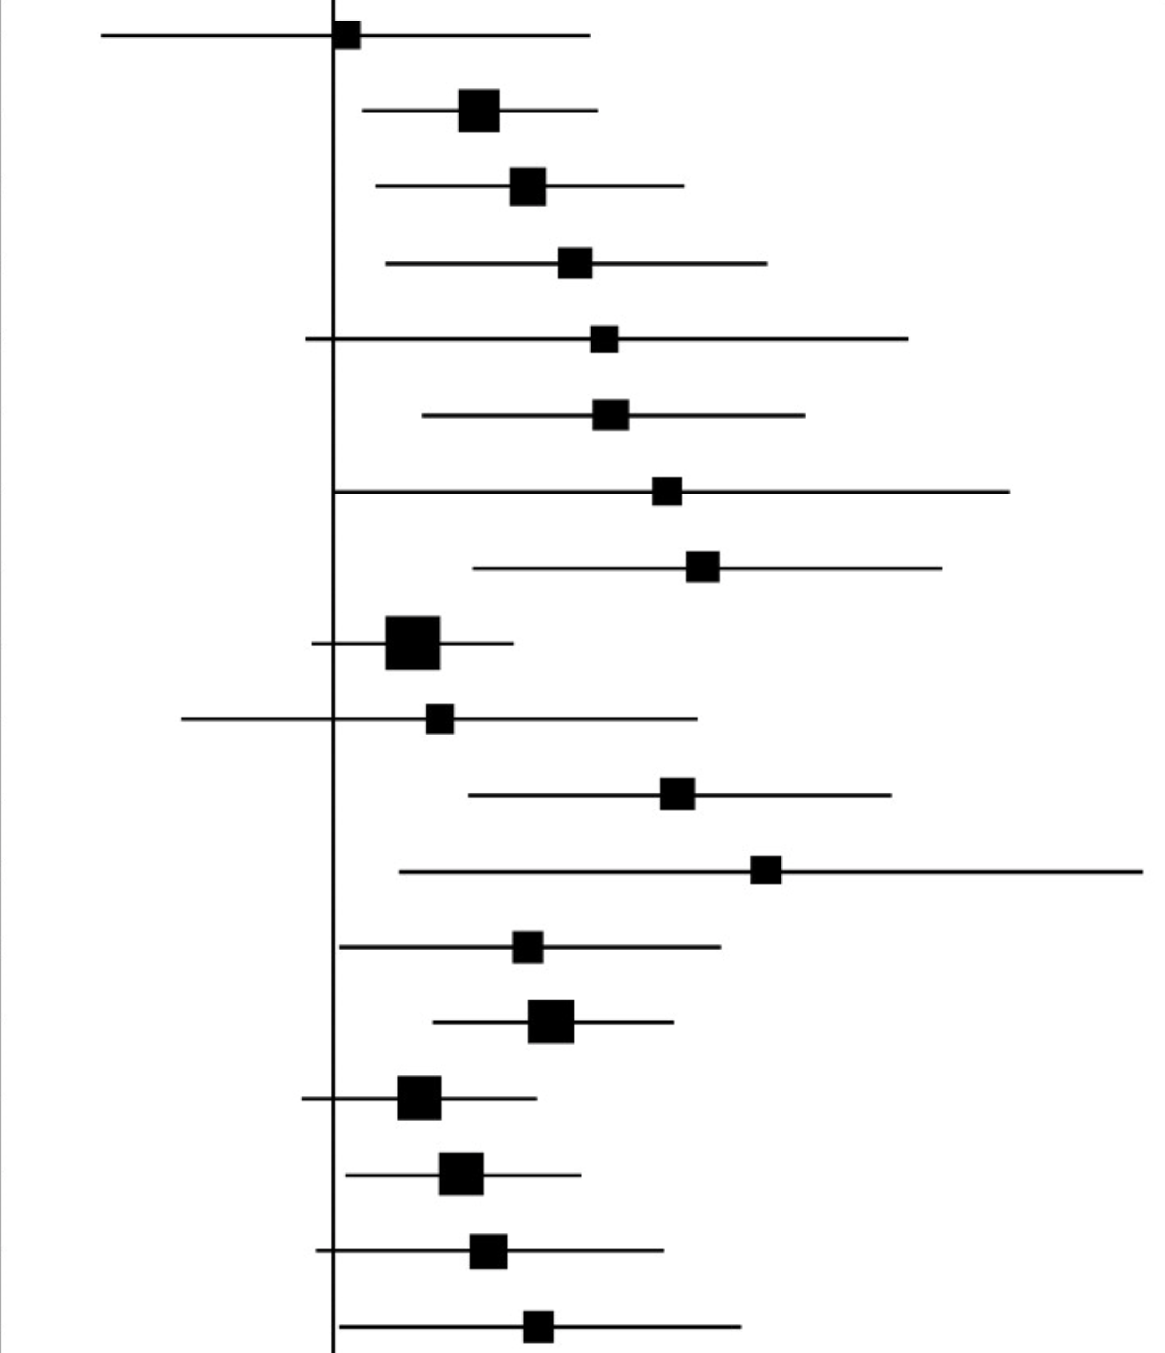
OCBs
…lubricate the social machinery of organizations, facilitating its effective functioning
- Bolino et al., 2002
…shape the org, social, and psych context acting as a catalyst for activities and processes
- Borman & Motowidlo, 1997
…given same weight as task performance on manager evaluations
- Podsakoff, MacKenzie, & Podsakoff, 2018
> 7
> 5

Slide 17
OCBs - dimensions

Slide 18
OCBs - dimensions
Altruism
Generalized Compliance

Slide 19
OCBs - dimensions
Altruism
Generalized Compliance
Altruism
Civic Virtue
Sportsmanship
Courtesy
Conscientiousness

Slide 20
OCBs - dimensions
Altruism
Generalized Compliance
Altruism
Civic Virtue
Sportsmanship
Courtesy
Conscientiousness
OCB-I
OCB-O

Slide 21
OCBs - dimensions
Altruism
Generalized Compliance
Altruism
Civic Virtue
Sportsmanship
Courtesy
Conscientiousness
OCB-I
OCB-O
Affiliative
Challenging

Slide 22
Pattern

Slide 23
Pattern
Extra Milers
- Li, Zhao, Walter, Zhang, & Yu, 2015
Good Soldiers
- Methot, Lepak, Shipp, & Boswell, 2017
- Bolino 2015

Slide 24


Pattern
Extra Milers
- Li, Zhao, Walter, Zhang, & Yu, 2015
Good Soldiers
- Methot, Lepak, Shipp, & Boswell, 2017
- Bolino 2015
OCBs

Slide 25
Pattern
Extra Milers
- Li, Zhao, Walter, Zhang, & Yu, 2015
Good Soldiers
- Methot, Lepak, Shipp, & Boswell, 2017
- Bolino 2015
OCBs

Slide 26
Pattern
Extra Milers
- Li, Zhao, Walter, Zhang, & Yu, 2015
Good Soldiers
- Methot, Lepak, Shipp, & Boswell, 2017
- Bolino 2015
OCBs
Time

Slide 27
Pattern
Extra Milers
- Li, Zhao, Walter, Zhang, & Yu, 2015
Good Soldiers
- Methot, Lepak, Shipp, & Boswell, 2017
- Bolino 2015
OCBs
Time

Slide 28
Pattern
Extra Milers
- Li, Zhao, Walter, Zhang, & Yu, 2015
Good Soldiers
- Methot, Lepak, Shipp, & Boswell, 2017
- Bolino 2015
OCBs
Time

Slide 29
Pattern
Extra Milers
- Li, Zhao, Walter, Zhang, & Yu, 2015
Good Soldiers
- Methot, Lepak, Shipp, & Boswell, 2017
- Bolino 2015
>
OCBs
Time

Slide 30
Predictors
Prosocial Motives | Personality Fairness | Values
Satisfaction
OCBs
Time

Slide 31
Alternative

Slide 32
Alternative
Situation
- Requests
Chance
- Random Walks

Slide 33
Alternative
Situation
- Requests
Chance
- Random Walks
OCBs

Slide 34
Alternative
Situation
- Requests
Chance
- Random Walks
OCBs

Slide 35
Alternative
Situation
- Requests
Chance
- Random Walks
>
OCBs
Time
Notes:
Why is that?

Slide 36
Alternative
Situation
- Requests
Chance
- Random Walks

Slide 37
Alternative
Situation
- Requests
Chance
- Random Walks

Slide 38
Alternative
Situation
- Requests
Chance
- Random Walks
>
Opportunity Stock
Employee_{i}
Opportunity Stock
Employee_{i+1}

Slide 39
Alternative
Situation
- Requests
Chance
- Random Walks
>
>
Opportunity Stock
Employee_{i}
Opportunity Stock
Employee_{i+1}

Slide 40
Alternative
Situation
- Requests
Chance
- Random Walks
>
>
>
Opportunity Stock
Employee_{i}
Opportunity Stock
Employee_{i+1}

Slide 41
Alternative
Study 1
- Requests follow random walks when they accumulate over time

Slide 42
Alternative
Study 1
- Requests follow random walks when they accumulate over time
Theory
- Simon/OCB/Stochastics

Slide 43
Alternative
Study 1
- Requests follow random walks when they accumulate over time
Theory
- Simon/OCB/Stochastics
Approach
- Archival

Slide 44
Alternative
Study 1
- Requests follow random walks when they accumulate over time
Study 2
- Randomly accumulating requests yield vast differences in opportunity
Theory
- Simon/OCB/Stochastics
Approach
- Archival

Slide 45
Alternative
Study 1
- Requests follow random walks when they accumulate over time
Study 2
- Randomly accumulating requests yield vast differences in opportunity
Theory
- Simon/OCB/Stochastics
Theory
- Probability
Approach
- Archival

Slide 46
Alternative
Study 1
- Requests follow random walks when they accumulate over time
Study 2
- Randomly accumulating requests yield vast differences in opportunity
Theory
- Simon/OCB/Stochastics
Theory
- Probability
Approach
- Archival
Approach
- Simulation

Slide 47
Discussion

Slide 48
Potential Issues

Slide 49
1) GitHub Issue Examples
https://github.com/rmcelreath/rethinking/issues/15
https://github.com/rmcelreath/rethinking/issues/38

Slide 50
2) OCB Opportunity Email Examples
I just learned that […]. I’m looking for someone who would be willing to help me cover my two undergrad IO class... I teach from 12:40-2pm on Tuesday and Thursday, and next week we’ll be covering criterion development and performance appraisal.
[Talk and post coffee session]

Slide 51
3) Is it really random?
Denrell
“Any model in which random variation is a fundamental component is a chance explanation.”
“A chance model incorporates unbiased variation as a key assumption to explain an empirical regularity.”
The fact that opportunities are randomly added or subtracted from the store of opportunities is a key aspect of the model. Without it, you wouldn’t see large differences in opportunity.

Slide 52
4) Subjective or Objective Requests?
Shocks in Lee’s unfolding model of turnover. An event that
initiates the psych analysis involved in quitting
jars employees toward deliberate judgment about leaving

Slide 53
5) Request from org outsiders?
That’s why I have both academic and non-academic
Academic = “outside” org
Non-academic (free-lance software) = “inside” org
(b) OCB-O items
Keep up with developments in org
Defend the org when others criticize it
Show pride when representing the org in public
Offer ideas to improve the org functioning
Demonstrate concern about the image of the org

Slide 54
5) Request from org outsiders?
(c) Bergeron, Ostroff, Schroeder, & Block, 2014
@ university, internal OCBs
Serve on committees
Attend major student events
Act like a peacemaker when departments disagree
“Touch base” with other faculty
Attend major student events to show support for the institution
@ professional, service OCBs
Serve as a discussant or chair at professional meeting
Serve as an officer for a professional association
Organize a meeting at professional association
Serve on journal editorial board

Slide 55
6) Common OCB Items
Lee & Allen, 2002
Coworkers indicate (never to always) how often the target person engaged in behaviors
OCBI
Help others who have been absent
Willingly give your time to help others who have work-related problems
Adjust your work schedule to accommodate other employees' requests for time off
Go out of the way to make newer employees feel welcome in the work group
Show genuine concern and courtesy toward coworkers, even under the most trying business or personal situations
Give up time to help others who have work or nonwork problems
Assist others with their duties
Share personal property with others to help with their work
OCBO
Attend functions that are not required but that help the organizational image
Keep up with developments in the organization
Defend the organization when other employees criticize it
Show pride when representing the organization in public
Offer ideas to improve the functioning of the organization
Express loyalty toward the organization
Take action to protect the organization from potential problems
Demonstrate concern about the image of the organization

Slide 56
7) Simulation Result

Slide 57
7) Own Questions
Fewer data sets?
Theory to predict that requests for help are random

Slide 58
8) Logic
requests may follow a random process (random walks)
(b) randomness can yield good soldiers

Slide 59
8) Logic
requests may follow a random process (random walks)
Archival
(b) randomness can yield good soldiers
1: random walks create differences in opportunity
2: opportunities relate to actions
Simulate

Slide 60
9) Logic – what our lit would do
requests follow random walks
(b) randomness can yield differences in opportunity
(c) opportunities relate to actions

Slide 61
9) Logic – what our lit would do
requests follow random walks
Theory
Data
(b) randomness can yield differences in opportunity
Theory
Data
(c) opportunities relate to actions
Theory
Data

